Slide 1
Post-COVID-19 Healthcare Analysis
Yuzhen Ye, Professor, Department of Computer Science
Shreeja Deshpande,TA

Slide 2



MEET OUR TEAM
Shubh Sanjeevkumar Mehta
Sarthak Choudhary
Niveditha Bommanahally Parmeshwarappa

Slide 3
AGENDA
Introduction and problem statement
Dataset
Exploratory data analysis
Modelling and algorithm
Conclusion

Slide 4
INTRODUCTION
As of August 2021, the world has faced unprecedented challenges due to the COVID-19 pandemic. With over 210 million confirmed cases and 4.4 million deaths reported worldwide, the post-COVID-19 landscape demands our attention.Current research indicates that about 10-20% of individuals experience various mid to long-term symptoms following their initial recovery, a phenomenon termed "post-COVID-19 condition." Our objective is to conduct in-depth research and analysis of the healthcare scenario in the aftermath of COVID-19, focusing on developing an optimal algorithmic model to predict these mid and long-term effects.

Slide 5
Dataset
The dataset used is focused on conditions contributing to COVID-19 deaths in the United States, covering the period from January 1, 2020, to September 23, 2023. Our chosen dataset includes more than 600,000 records, spanning diverse countries, age demographics, and pre-existing health conditions.Our dataset contains Data As Of,Start Date,End Date,Group,Year,Month,State,Condition Group,Condition,ICD10_codes,Age Group,COVID-19 Deaths,Number of Mentions,Flag columns

Slide 6
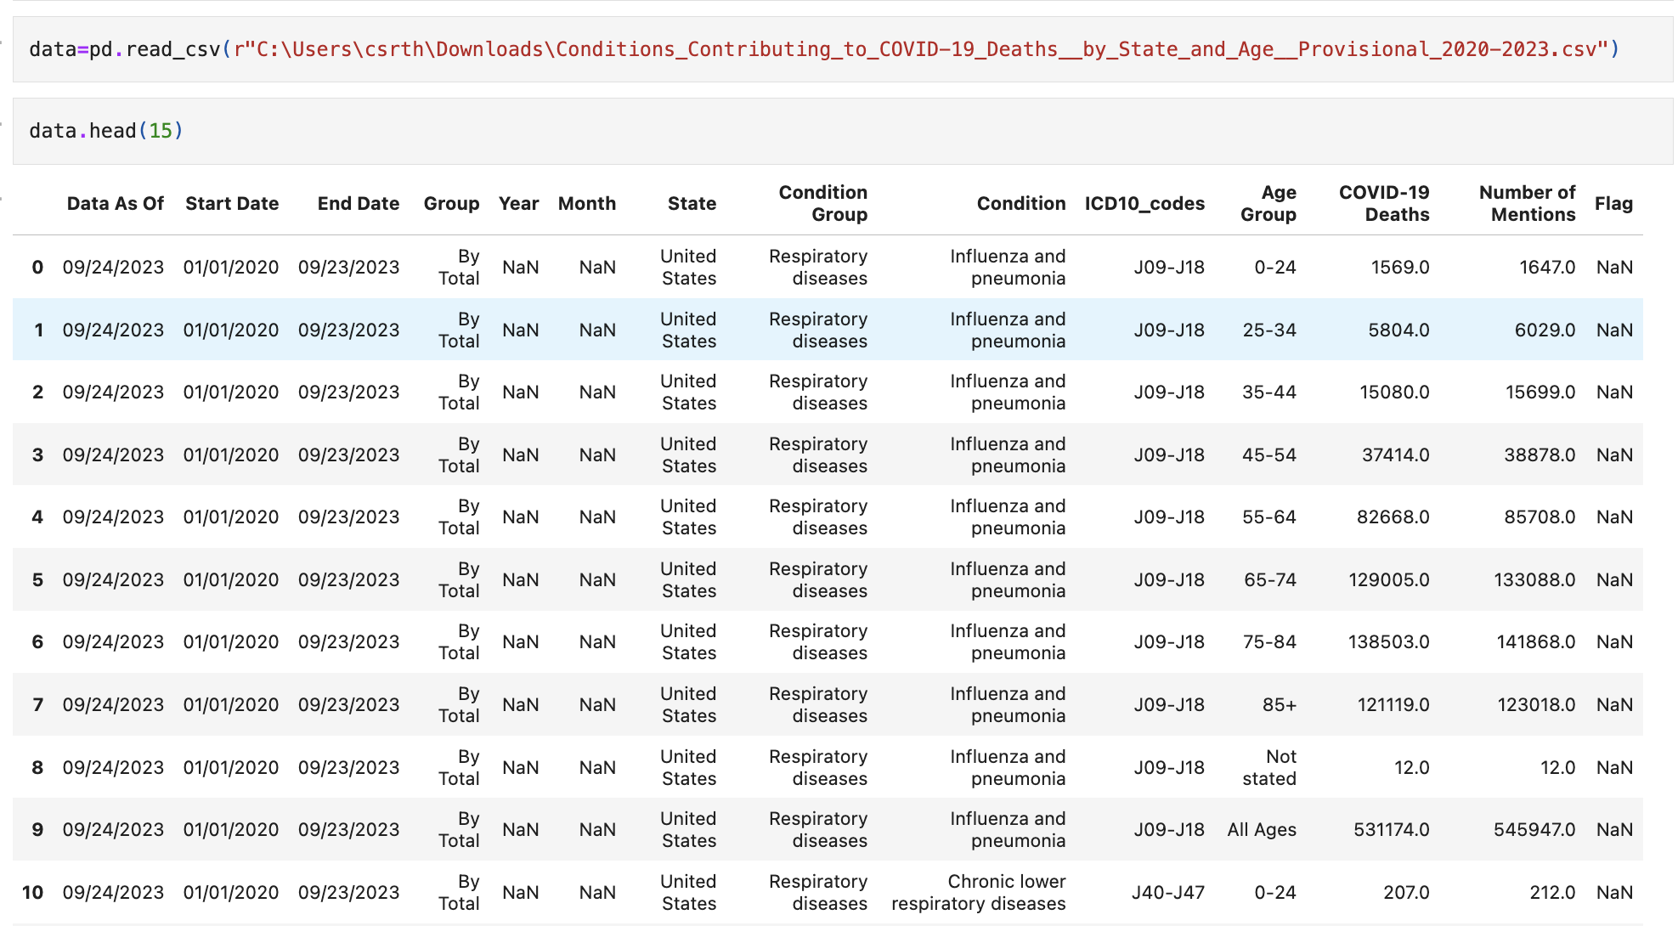

Slide 7
Exploratory data analysis
On our eda we did handling missing values, by using iterative imputation methods, and encoding categorical variables using techniques like label encoding.
Additionally, we did the data standardizing to normalize or standardize the values, which is a common practice before applying machine learning models. Our dataset contain multiple column whose data type were in 'object' format, so we grouped them, and change assigned the group value in numerical format.

Slide 8
Analysis
Segmentation Analysis:
The analysis revealed the patterns and trends specific to each segment, such as the prevalence of COVID-19 deaths in different age groups or the impact of pre-existing health conditions. It provided a granular understanding of the data, enabling targeted insights.
Time Series Analysis:
The key insights from this analysis includes identifying trends in COVID-19 deaths over the years, understanding how the impact of the virus changed over time, and potentially forecasting future trends. It also highlighted periods with significant increases or decreases in COVID-19-related fatalities.
In summary, the segmentation analysis provides a detailed breakdown of the data into meaningful groups, offering insights specific to each segment. In contrast, the time analysis offers a dynamic view of the data, focusing on changes and trends over the specified period

Slide 9
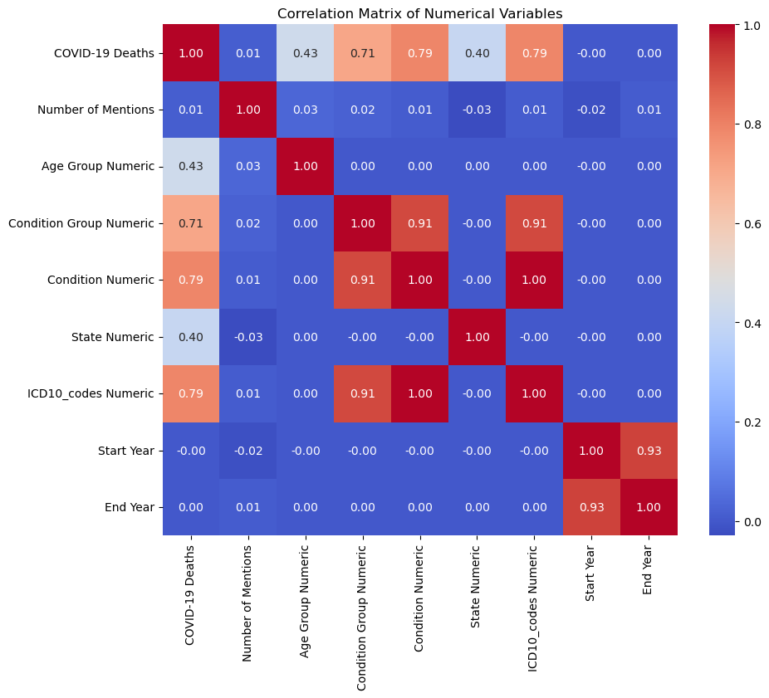
Correlation matrix analysis
Strong Correlations: There are strong positive correlations between 'Condition Group Numeric' and 'Condition Numeric' as well as 'ICD10_codes Numeric', which suggests that these variables, which likely represent different ways of categorizing health conditions, move together. When one increases, the others tend to increase as well, which could be due to the similar way these categorizations are structured.
Moderate Correlations: 'COVID-19 Deaths' shows moderate positive correlations with 'Condition Group Numeric', 'Condition Numeric', and 'ICD10_codes Numeric'. This indicates that certain conditions or categorizations of conditions are moderately associated with the number of COVID-19 deaths.
Weak/No Correlations: There is little to no correlation between 'COVID-19 Deaths' and 'Start Year' or 'End Year', as well as between 'Number of Mentions' and most other variables. This implies that the timing of the data (year) does not have a linear relationship with the number of deaths or mentions.

Slide 10
Modelling and algorithm
LightGBM (Light Gradient Boosting Machine)
MLP (Multi-Layer Perceptron)
XGBoost (eXtreme Gradient Boosting)
Gradient Boosting
MLP is a type of neural network used for solving both regression and classification problems.
It consists of multiple layers of nodes, each connected to the nodes of the next layer, typically using a non-linear activation function.
MLP is useful in capturing complex patterns in data, but requires careful tuning of parameters like the number of layers and nodes, activation functions, and optimization techniques.
It's part of deep learning and performs well on large and complex datasets but can be prone to overfitting and computationally intensive
Gradient Boosting is an ensemble learning technique that builds multiple decision trees sequentially, with each tree trying to correct the errors of its predecessor.
It combines weak learners (usually decision trees) to create a strong learner in an iterative fashion.
Gradient Boosting is effective for both regression and classification problems, offering high accuracy but can be prone to overfitting.
It requires careful tuning of parameters like the number of trees, depth of trees, learning rate, and loss functions.
XGBoost is an optimized and scalable version of gradient boosting, known for its performance and speed.
It provides a parallel tree boosting algorithm that is efficient, flexible, and portable.
XGBoost has become a de facto standard for winning many machine learning competitions because of its robustness and effectiveness in handling a variety of data types.
It includes features like handling missing values, regularization to avoid overfitting, and built-in routines for cross-validation.
LightGBM is a gradient boosting framework that uses tree-based learning algorithms and is designed for distributed and efficient training, especially on large datasets.
It uses a histogram-based algorithm for speed and reduces memory usage compared to other implementations of gradient boosting.
LightGBM supports categorical features directly and is capable of handling large-scale data with ease.
While it's faster and more efficient than traditional gradient boosting, careful handling of overfitting and parameter tuning is necessary for optimal performance.

Slide 11
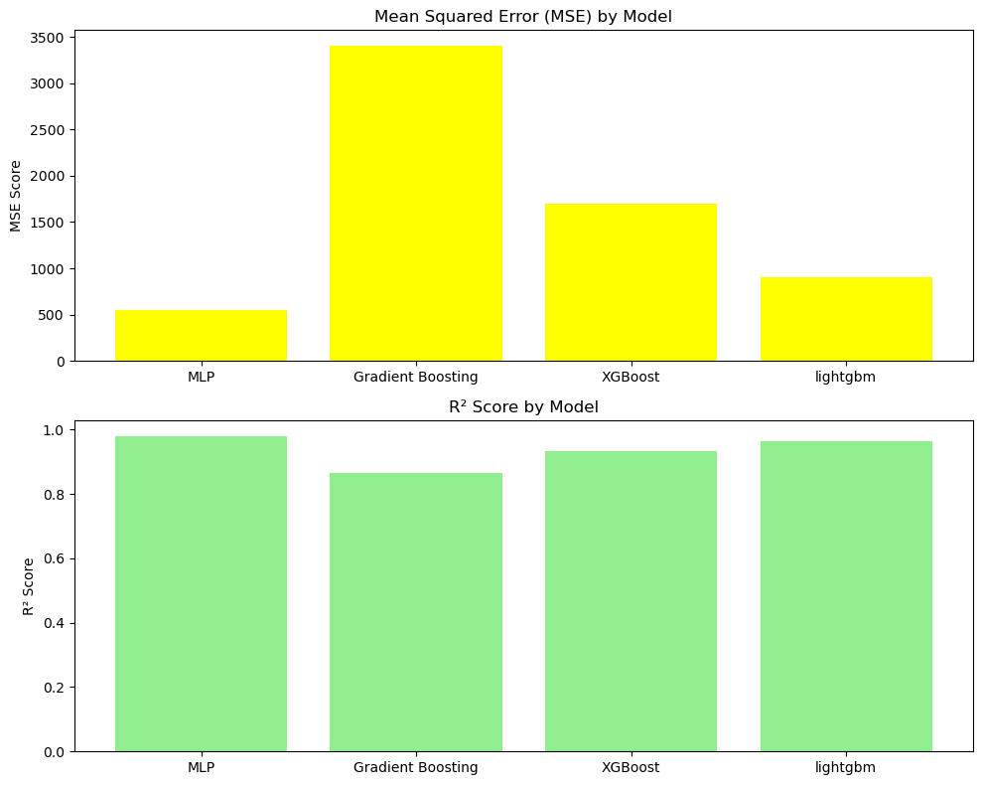
Results
​ | MLP | Gradient Boost | XG Boost​ | LightGBM​
R2 score | 0.9784518939909896​ | 0. 8663836783390868 | 0. 9330953586326107​ | 0. 9643330146212238
MSE score | 548.6644872976882​ | 3402.179782670135 | 1703.5465083717688​ | 908.1637262280739

Slide 12
SUMMARY
The Multilayer Perceptron (MLP) model performed the best out of the four models, with the lowest MSE score of 548.66 and the highest R2 score of 0.978. This indicates the MLP model made the most precise predictions overall.
The XGBoost model performed second best with a low MSE score of 1703.55 and a high R2 score of 0.933, indicating generally accurate predictions but not as good as the MLP model.
The LightGBM model performed third best with an MSE of 908.16 and R2 of 0.964, demonstrating good but not great predictive capabilities.
The Gradient Boosting model performed the worst, with a much higher MSE score of 3402.18 and a lower R2 score of 0.866 compared to the rest. The high MSE indicates this model's predictions substantially deviated from true values, while the lower R2 signals weaker correlation between predictions and targets.
In summary, the MLP model made the most accurate predictions while the Gradient Boosting model struggled to make precise predictions compared to the other three models, based on their respective MSE and R2 metrics.

Slide 13
THANK YOU
Shubh Sanjeevkumar Mehta
Sarthak Choudhary
Niveditha Bommanahally Parmeshwarappa

